Slide 1

DriverPass System Analysis
VICTOR NGETICH

Slide 2

System Requirements
Functional requirements
User registration and login functionality for students, instructors, and administrators.
DMV update notification system to inform the client of any changes.
Non-Functional requirements
Page load times should not exceed 2 seconds.
It should be capable of supporting at least 100 simultaneous users without performance degradation.
The system should accommodate future updates, such as new training packages or changes to DMV regulations.
Notes:
So here's a brief summary of what the system needs to do, and how it needs to do it.
We'll start with the functional things in essence, what the system really does. We need to make sure that students, teachers, and admins can all signup and login. Each will have different things they can do, depending on what role they're in. We're also adding a super useful feature: an update notification system for DMV updates. This will alert users whenever there are changes in DMV rules or requirements super useful so they won't be caught off guard.
Now on to the non-functional requirements these are more related to the system's behavior. First, speed is important. Nobody wants to wait, so we want each page to load within less than two seconds. We're also making sure the system will be able to handle at least 100 people using it at the same time without slowing down or crashing. And finally, we're designing with the future in mind so if new training modules come about, or the DMV makes a change, we can just update the system without having to start over from scratch.
So in short, we're trying to find something that gets the job done, gets it done fast, and can handle future demands.

Slide 3
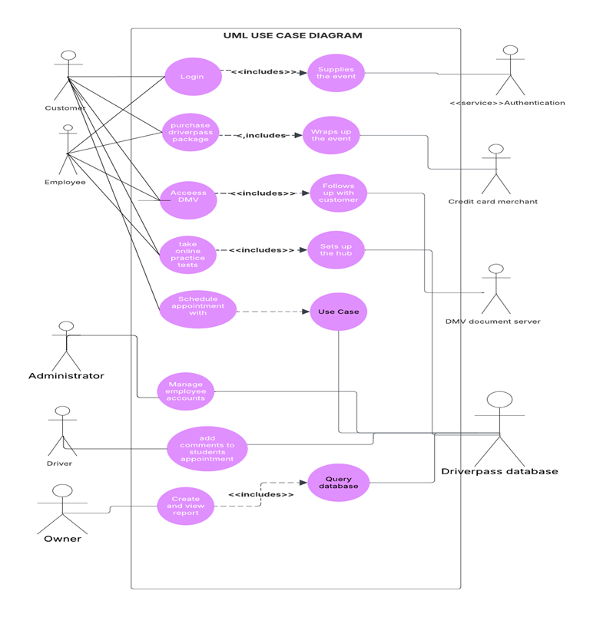
Use Case Diagram
[Insert your use case diagram here.]
Notes:
We have designed this system to have multiple types of users. We have customers, employees, administrators, drivers, and the business owner each having multiple types of roles and activities that they can perform.
For example, they are able to log in, buy a DriverPass package, rehearse using online tests, access DMV information, and make appointments. The staff members help with making and processing DMV-related appointments as well. This allows the customers to enjoy all the conveniences they need in their learning process.
Administrators also have a significant role to play in keeping employee accounts and running the system smoothly. Drivers and instructors can add notes against student appointments, and the owner is able to create and see reports to monitor activity and progress.
We’ve also connected the system to important external services. For example, there's an authentication system to handle secure logins, a credit card service for payments, and DMV servers for getting up-to-date info. Everything flows through a central database that stores and manages all the system’s data.
This framework allows for Driver Pass's goals to be achieved completely from enabling students to ready and schedule appointments, to making sure that management and staff are equipped with the necessary tools to serve users better.

Slide 4
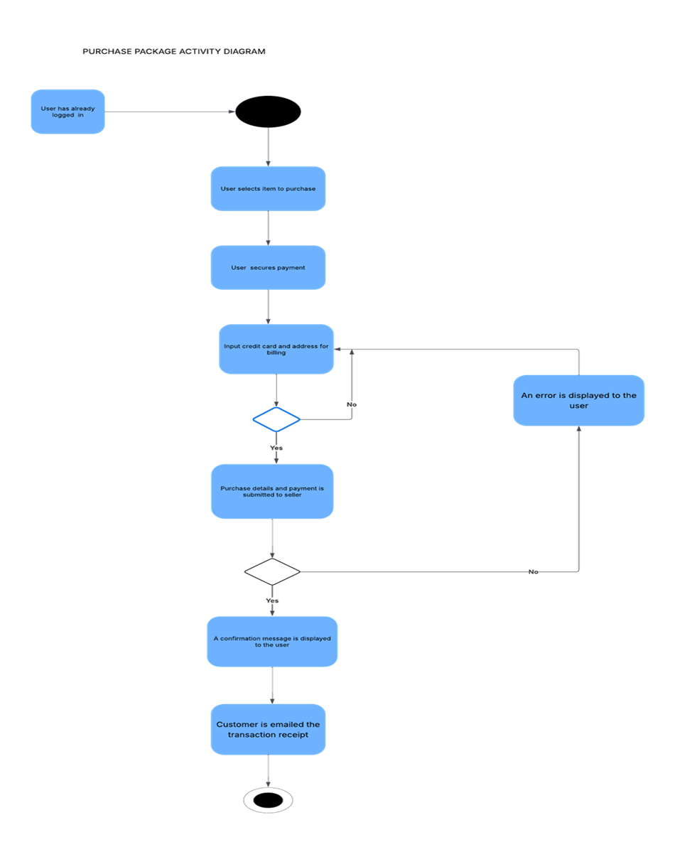
Activity Diagram
Notes:
This chart illustrates the easy process that a user has to follow to purchase a Driverpass training package. After being logged in, the user selects the training module he or she would like and proceeds to enter payment details. These are checked by the system. If payment is successful, then the user receives an on-screen message as well as an e-mailed transaction receipt to his or her e-mail address. If there is an issue with a payment, the system automatically warns the user that they can re-enter their information and try again. This entire process outlines the 'Purchase Training Package' use case, the bare minimum of steps a user has to undertake in order to buy access to Driverpass instruction. This reduced process allows customers to easily and securely pay and begin their Driverpass training.

Slide 5
Security
Security concerns
Implement AES-256 encryption to protect sensitive data.
Use role-based access controls, with specific permissions for administrators, instructors, and students.
Maintain detailed activity logs for audit and troubleshooting purposes.
Notes:
When designing the process, I was careful to think about how to safeguard users and maintain their information confidential. For example, when a user signs up or logs in, the system checks that the email and password were entered correctly. This way, only the right person can access their account.
Also, whenever a student makes payment for his lessons, the payment information is handled with care and safety so that they don't leak out or get used inappropriately. I also made sure that any personal details like names, contact numbers, or timetables are not disclosed to anyone else and are kept confidential.
By adding these security measures, the design makes students feel safe and comfortable using DriverPass, with the confidence that their information is properly being cared for.

Slide 6
System Limitations
Limitations
The first release of the system only permits basic package configuration items to enable and disable functionality.
Offline data modification is not permitted within the system for data integrity.
Limitations and time and budget constraints will be determined by Driver Pass.
The logging and auditing capabilities of the system are low, and it would be difficult to debug problems and monitor changes.
The system does not have any sophisticated data migration tooling for legacy systems.
Notes:
As with any design, our Driverpass system does have some places where we've focused our initial efforts, and others where we see potential to construct from in the future. Being honest about these beginnings is the best approach.
For example, in this initial cut, our primary focus is on web-based training content. Okay, we do have the start of different types of training packages, but instant access to a wide variety of very interactive simulations or on-site scheduling functionality might be restricted. We see these as potential for exciting future growth.
Also, although the system is able to handle a decent number of users with no issues, there's always a limit. If we were to all of a sudden have a massive influx of users at the same time, there could be some short-term slowdown, though we've built it to handle normal growth.
Early on, our integration with other external systems, like some driving school scheduling software which some of you might already be utilizing, could be straightforward. We anticipate exploring further integrations based on your requirements and feedback in the future.
Finally, while we've worked hard to deliver a highly usable experience on different devices, the initial design is primarily optimized for computers and tablets. To optimize completely for all possible older mobile phone models might be something that we condense further according to usage patterns.
Consider this initial design as a solid and solid foundation. We've given priority to the fundamental learning experience and a stable platform. We listen to your input and work continually to enhance and grow the Driverpass system to address your changing needs.

